Slide 1
Chapter 1
People, Politics, and Participation
American Democracy Now, 7th edition
Brigid Callahan Harrison
Jean Wahl Harris
Michelle D. Deardorff
Copyright 2022 © McGraw Hill LLC. All rights reserved. No reproduction or distribution without the prior written consent of McGraw Hill LLC.

Slide 2
y shd u stdy am dem now? Or, Why Should You Study American Democracy Now?
Politics: the process of deciding who benefits in society and who does not.
Politics practiced today is a much different process than it was even a decade ago.
What’s changed?
Technology, in terms of both how people communicate and how governments provide information.
World events.

Slide 3
How Technology Has Changed Politics
Faster computers, the Internet, micro-targeting, and social media.
Information sources: Facebook, Twitter, and Internet-based news sites and blogs.
Campaigns: e-mail, text messaging, and social networking sites.
Computers are now used to conduct elections and to provide government services.
Because of these changes, Americans face both new opportunities and new challenges.

Slide 4
The Political Context Now
Current debates are over the size and role of government, how to foster economic development, and issues of health care and law enforcement.
Global environment is characterized by uncertainty and instability on many fronts.
North Korea, Russia, and China.
Multiple issues in the Middle East.

Slide 5
Americans’ Efficacy
Americans today demonstrate increased cynicism, lower trust in government, lack of efficacy, and apathy.
Low voter turnout.
Many young people are enthusiastic participants in civic and political life.
Benefits of civic engagement: increased knowledge, better communication, and the ability to advocate for one’s interests.
Local communities, states, and the nation in turn benefit from an engaged populace.

Slide 6
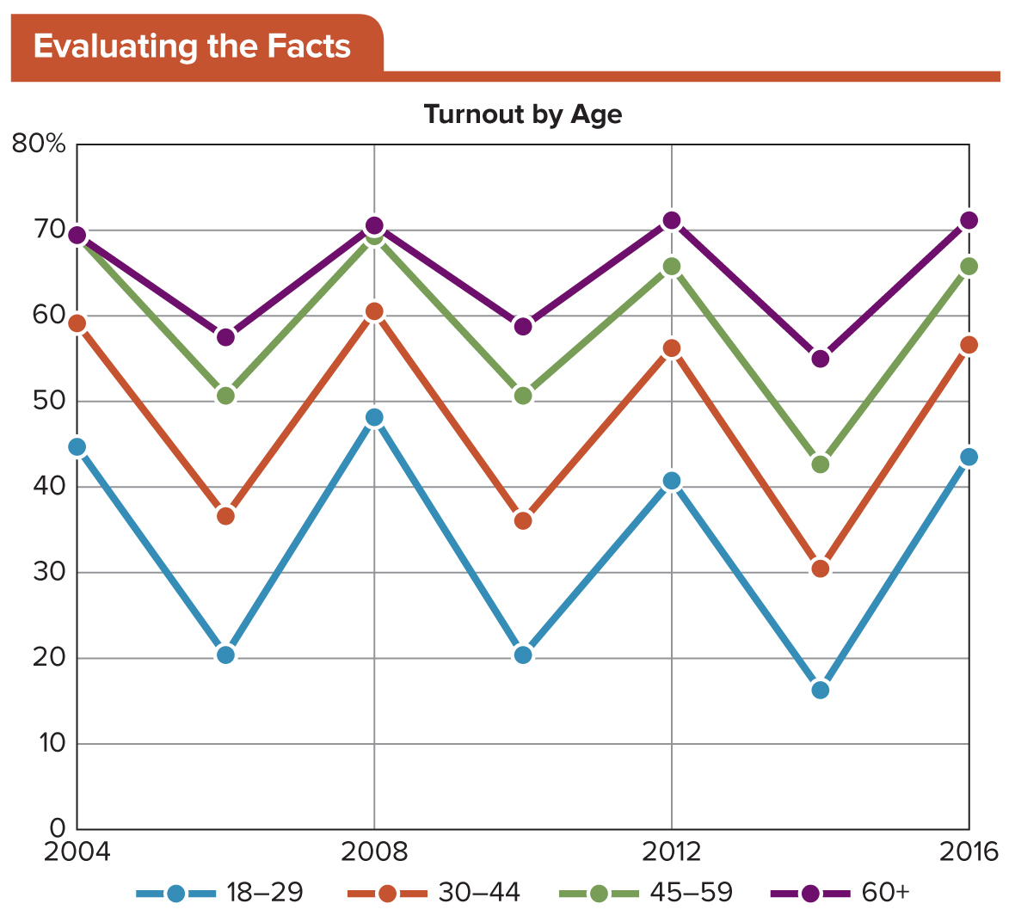
Figure 1.1 Voter Turnout in Presidential Elections (2004 to 2020) by Voter Age
How has the turnout rate changed over time for voters aged 18 to 29? For other age groups?
Access the text alternative for slide images.
SOURCE: United States Elections Project.

Slide 7
Civic Engagement: Acting on Your Views
Civic engagement: individual and collective actions designed to identify and address issues of public concern (e.g. volunteering, group involvement, campaigning).
Political engagement: citizen actions intended to solve problems through political means.
Get involved!

Slide 8
What Government Does 1
Key functions of governments such as that of the United States:
To protect their sovereign territory and their citizens and to provide national defense.
To preserve order and stability.
To establish and maintain a legal system.
To provide services.
To raise and spend money.
To socialize new generations.

Slide 9
What Government Does 2
Citizens are those members of a political community who enjoy the rights, privileges, and responsibilities attached to membership.
Naturalization: the process of becoming a citizen by means other than birth, as in the case of immigrants.
Governments perform their functions on the basis of legitimacy—a quality conferred by citizens who believe its exercise of power is right and proper.
Many of the services provided are public goods: those that cannot be limited and are available to all.

Slide 10
Types of Government 1
Monarchy: usually a single ruler—a king or queen with absolute authority over a territory.
Most modern monarchies are constitutional monarchies, in which the monarch is ceremonial.
Oligarchy: an elite few hold power.
Democracy: the supreme power of governance is in the hands of citizens.
Most modern democracies are republics or representative democracies.

Slide 11
Types of Government 2
Totalitarianism: government controls every aspect of citizens’ lives.
Example: North Korea.
Authoritarianism: government holds strong powers, but they are checked by other forces in society.
Examples: China, Cuba.
Constitutionalism: government is structured by law, providing for limited government.

Slide 12
The Origins of American Democracy
Ancient Greeks developed the concept of democracy.
Citizens decided public issues in city-states based on majority rule.
Women and slaves were not counted as citizens.
American democracy traces some of its roots to the Judeo-Christian tradition and English common law, particularly the ideas of the Protestant Reformation.

Slide 13
Democracy’s Origins in Popular Protest: The Influence of the Reformation and the Enlightenment
Divine right of kings: assertion that monarchies could rule absolutely.
Protestant Reformation challenged basic tenets of Catholicism.
Puritans asserted their right to communicate directly with God through prayer.
Mayflower Compact: example of a social contract.
Enlightenment: philosophical movement emphasizing individuality, reason, and scientific endeavor.
Isaac Newton: natural law.

Slide 14
The Modern Political Philosophy of Hobbes and Locke 1
Thomas Hobbes, Leviathan (1651):
Social contract between an absolute sovereign and the people.
Sovereign provides protection, while the people relinquish rights.
John Locke, Two Treatises on Civil Government (1689):
Took the concept of a social contract further.
Government is required to protect people’s natural rights in return for popular acceptance of governmental authority.
People have the right to rebel in the absence of such protection.

Slide 15
The Modern Political Philosophy of Hobbes and Locke 2
Popular sovereignty: from Jean-Jacques Rousseau; government is created by the people and depends on the people for the authority to rule.
Social contract theory: assumes individuals possess free will, the God-given right of self-determination, and the ability to consent to be governed.

Slide 16
The Creation of the United States as an Experiment in Representative Democracy
Logic behind the rejection of the divine right of kings: people could govern themselves.
Direct democracy: all citizens discuss and decide policy through majority rule.
Indirect democracy (representative democracy): system in which citizens elect representatives who decide policies on behalf of their constituents.

Slide 17
Political Culture and American Values 1
Political culture: the people’s collective beliefs and attitudes about government and the political process.
Liberty: both freedom from governmental interference in citizens’ lives and freedom to pursue happiness.
Notions of equality have evolved over time.
Founders’ ideas evolved from the Greeks’ emphasis on equality of opportunity.
Struggle for legal equality continues today.
Many modern arguments focus on issues of economic equality.

Slide 18
Political Culture and American Values 2
Capitalism: economic system in which the means of producing wealth are privately owned and operated to produce profits.
Pure versus regulated capitalism.
Key component: property.
Consent of the governed: government’s power derives from consent of the people.
Majority rule is implied.
Emphasis on individual—and family and community— has played a central role in the U.S. political culture.

Slide 19
Ideology: A Prism for Viewing American Democracy 1
Political ideology: integrated system of ideas or beliefs about political values and about the role of government.
Liberalism: ideology that advocates change in the social, political, and economic realms to better protect the well-being of individuals and to produce equality in society.
Associated with the ideas of liberty and political equality.
Classical liberalism differs from modern liberalism.

Slide 20
Ideology: A Prism for Viewing American Democracy 2
Conservatism: ideology that emphasizes preserving tradition and relying on community and family as mechanisms of continuity in society.
Importance of order and stability.
Emphasis on individual initiative, rule of law, limited government authority, and the free market.

Slide 21
Ideology: A Prism for Viewing American Democracy 3
Other ideologies on a traditional spectrum:
Socialism: ideology that stresses economic equality, theoretically achieved when the government or workers own the means of production.
Libertarianism: government should take a “hands-off” approach in most matters.
Multidimensional political models: multidimensional scales measure people’s opinions on the role of government in the economy on one axis and their beliefs about personal freedom on second axis.

Slide 22
Table 1.1 The Traditional Ideological Spectrum
GOAL/ROLE | SOCIALISM | LIBERALISM | MIDDLE OF ROAD (MODERATE) | CONSERVATISM | LIBERTARIANISM
GOAL OF GOVERNMENT | Equality | Equality of opportunity: protection of fundamental liberties | Nondiscrimination in opportunity; protection of some economic freedoms; security; stability | Traditional values; order; stability; economic freedom | Absolute economic and social freedom
ROLE OF GOVERNMENT | Strong government control of economy | Government action to promote opportunity | Government action to balance the wants of workers and businesses; government fosters stability | Government action to protect capitalist system; few limitations on fundamental rights | No government regulations or economy; no limitations on fundamental rights
Table divided into six columns summarizes the traditional ideological spectrum. Column 1 notes goal and role of government. The column headers from 2 to 6 are marked as: Socialism, liberalism, middle of road (moderate), conservation, and libertarianism.

Slide 23
The Changing Face of American Democracy
U.S. population is growing—and on the move.
Population is also aging and becoming increasingly diverse.
U.S. families have changed.
Number of nonfamily households and households headed by single people have increased.
Changing population matters for politics and government.
May create new demands or indicate different priorities.

Slide 24
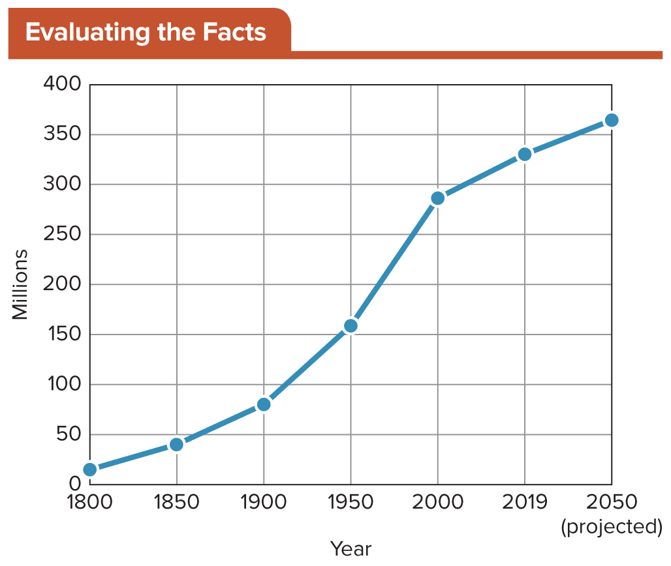
Figure 1.2 Growth of the U.S. Population from 1800 to 2050
The U.S. population increased gradually, and it did not reach 100 million until the second decade of the 20th century. What factors caused the steep rise during the 20th century? How will these forces continue to affect the size of the U.S. population during this century?
SOURCE: U.S. Census Bureau.

Slide 25
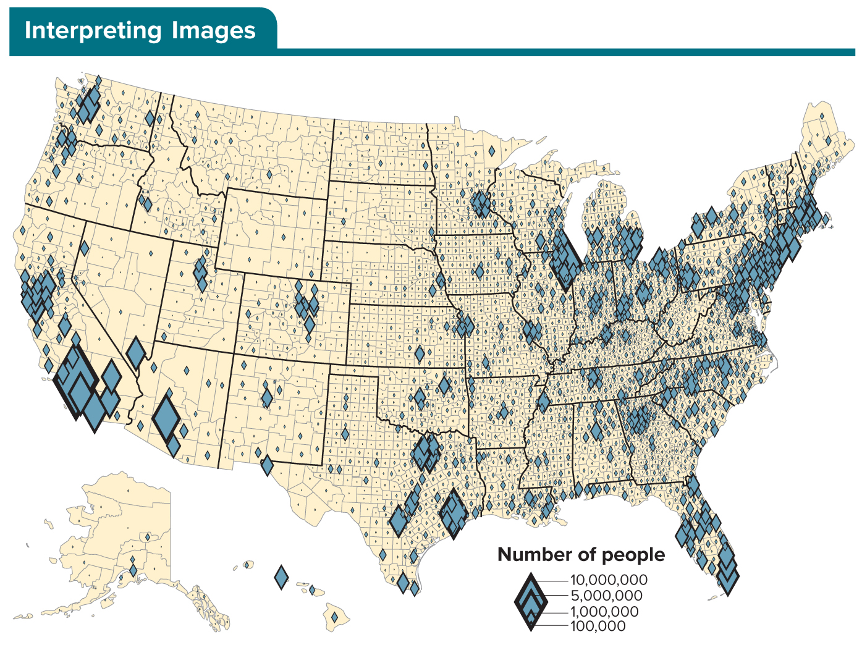
Figure 1.3 Population Distribution by County
The area of each diamond symbol is proportioned by the number of people in a county. The legend presents example symbol sizes from the many symbols shown on the map. Where are the largest population centers in the United States? What areas have comparatively sparse population?
Access the text alternative for slide images.
SOURCE: U.S. Census Bureau

Slide 26
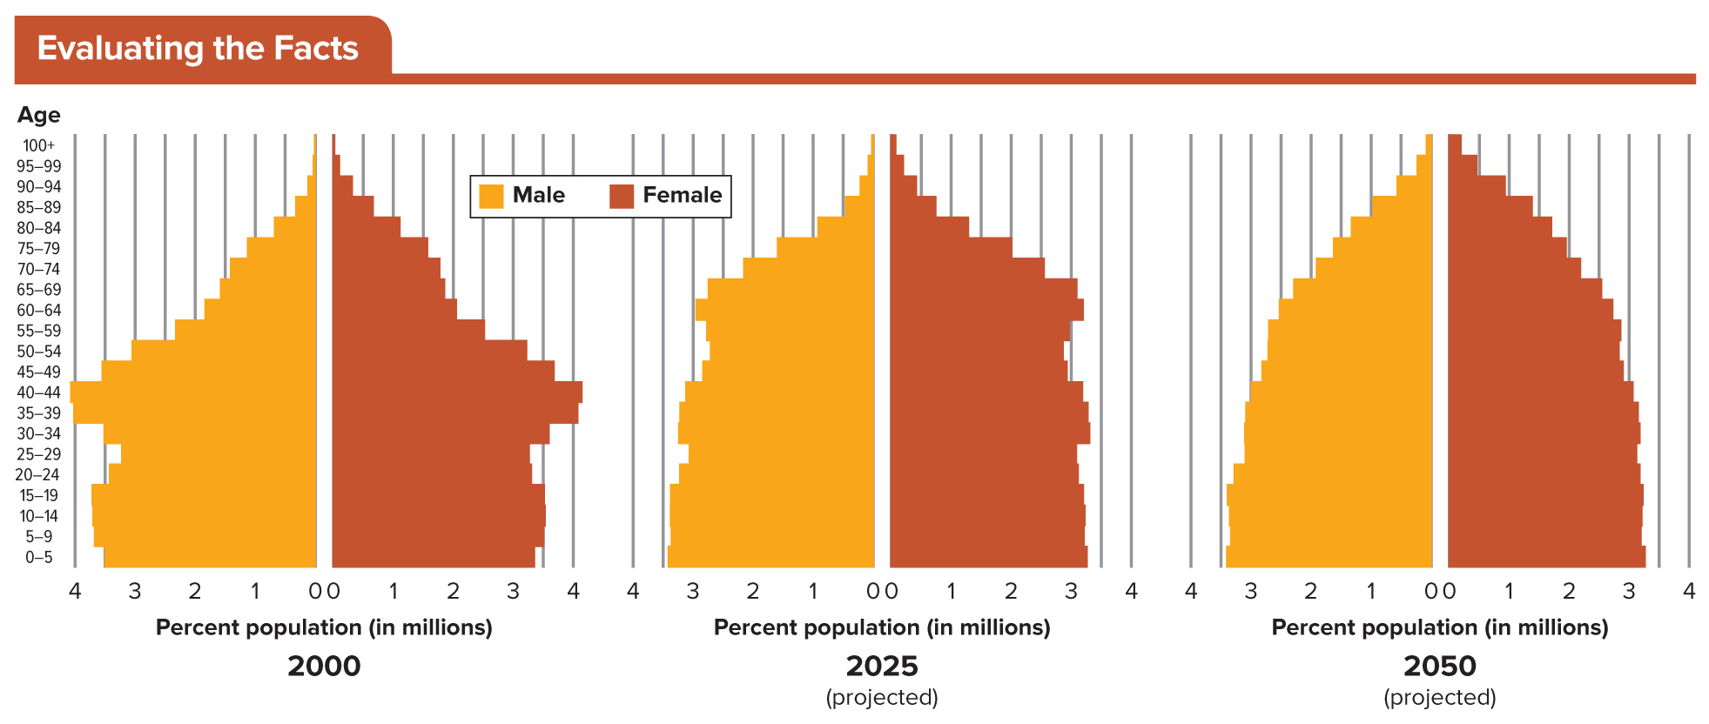
Figure 1.4 The Aging U.S. Population, 2000 to 2050
What effect will the changing age distribution of the U.S. population have on demand for services in 2025? In 2050? Given what you know about the racial composition of the Millennial generation, what will that mean for the racial composition of the U.S. population as it ages?
Access the text alternative for slide images.
SOURCE: U.S. Census Bureau

Slide 27
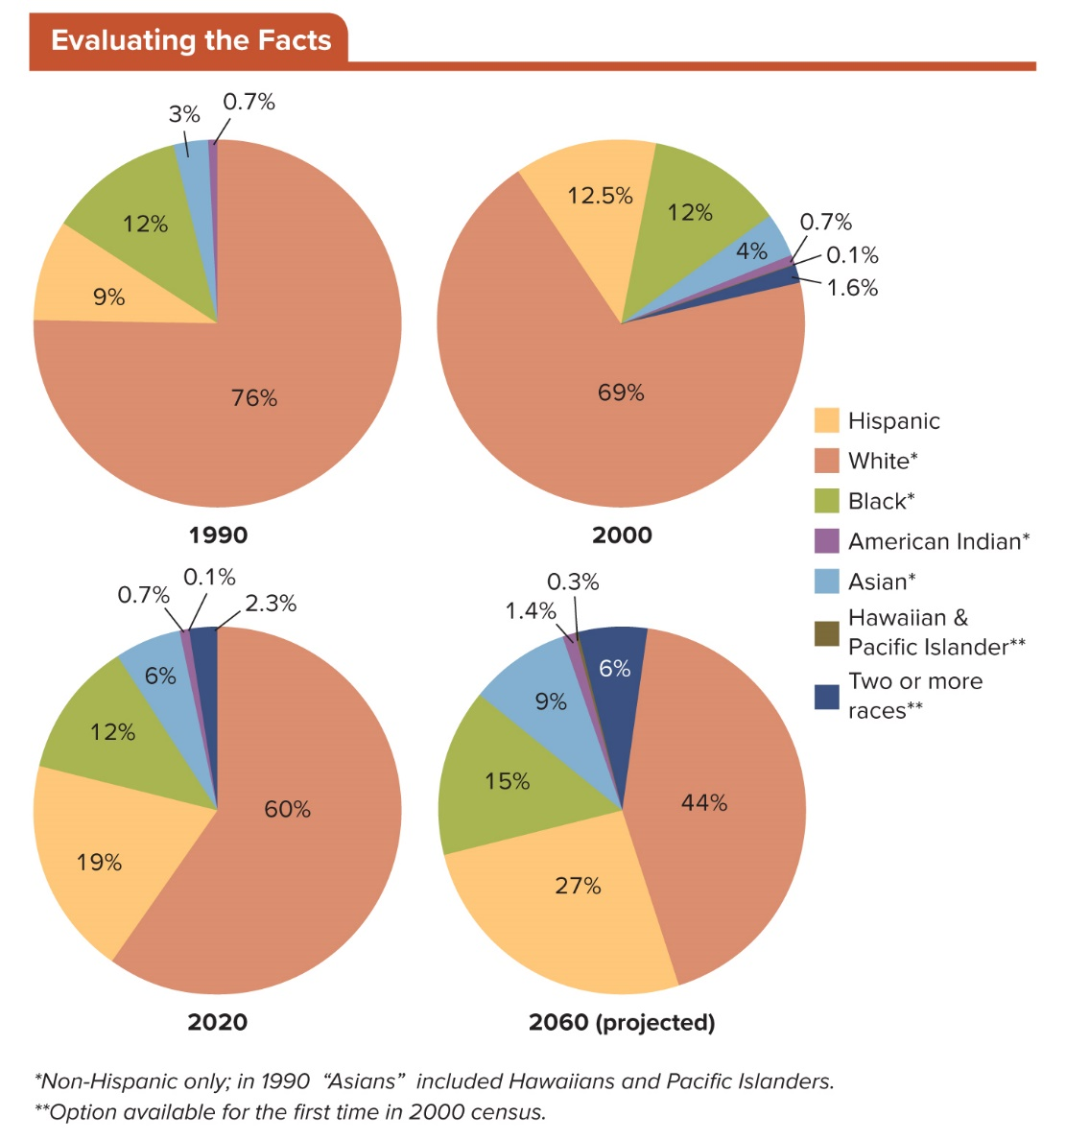
Figure 1.5 Population by Race, 1990 to 2060
Note that in the above figure, “white,” “Black,” “American Indian,” and “Asian” refer to non-Hispanic only; and in 1990, “Asian” included Hawaiians and Pacific Islanders. The options of “Hawaiian & Pacific Islander” and “Two or more races” were available for the first time in the 2000 census.
Access the text alternative for slide images.
SOURCES: Social Science Data Analysis Network, University of Michigan; and U.S. Census Bureau.

Slide 28
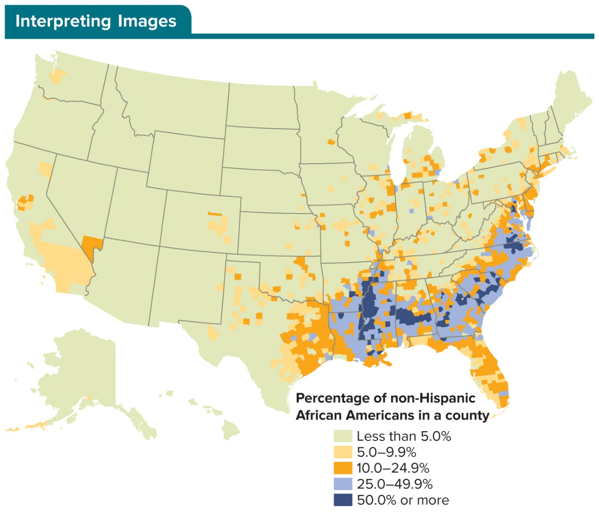
Figure 1.6 Where African Americans Live
Given that African American voters are a core constituency of the Democratic Party, how might the distribution of this group of voters affect electoral politics in these regions? Are there national implications for this trend?
Access the text alternative for slide images.
SOURCE: U.S. Census Bureau, Census Data Mapper.

Slide 29
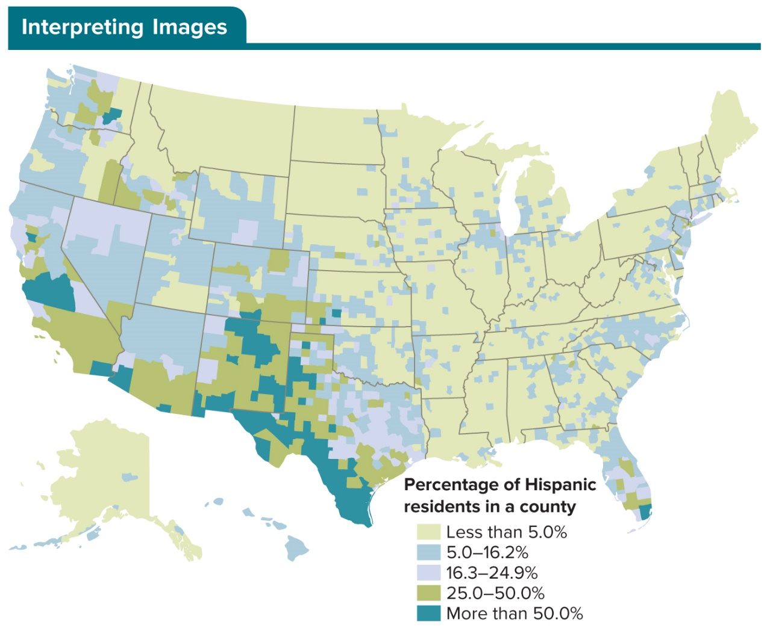
Figure 1.7 Where Hispanics Live
How might higher populations of Hispanics influence political culture in these regions? Do you think these Hispanic populations are homogeneous in their outlook? What policies might be priorities for majorities of Hispanics?
Access the text alternative for slide images.
SOURCE: U.S. Census Bureau, Census Data Mapper.

Slide 30
Review 1
Then—Cynicism, distrust, and apathy characterized Americans’ relationship with their government for the past generation.
Now—Polarization and anger characterize segments of the American electorate, and mistrust is rampant.
But new technologies and increasing participation among Millennials and Gen Z voters give some cause for optimism as the nation faces today’s challenges, including recovery from a global pandemic, as well as continued inequality, and the threat of terrorism and violence.

Slide 31
Review 2
Next:
Will the present generation break the cycle of cynicism and, increasingly, anger that has pervaded the politics of the recent past?
Will new information technologies continue to facilitate and energize political participation?
Will our nation’s increasing diversity continue to tear our nation apart or eventually serve to create compassion, respect, and unity?

Slide 32
Questions?

Slide 33
End of Main Content
Copyright 2022 © McGraw Hill LLC. All rights reserved. No reproduction or distribution without the prior written consent of McGraw Hill LLC.

Slide 34
Accessibility Content: Text Alternatives for Images

Slide 35
Figure 1.1 Voter Turnout in Presidential Elections (2004 to 2020) by Voter Age – Text Alternative
Return to parent-slide containing images.
Voter turnout has been higher for all other age groups; and voter turnout rises with age.
Of voters aged 30 to 44, about 60% voted in 2004 and 2008; about 56% in 2012; and about 57% in 2016.
Of voters aged 45 to 59, about 70% voted in 2004 and 2008; and about 65% voted in 2012 and 2016.
Of voters aged 60+, about 70% voted in each presidential election, with the percentage rising slightly in 2012 and 2016.
The figure also shows that voter turn out drops considerably in midterm (non-presidential) election years—more dramatically for the younger age groups than for those in the 60+ group.
Return to parent-slide containing images.

Slide 36
Figure 1.3 Population Distribution by County – Text Alternative
Return to parent-slide containing images.
Density map showing the distribution of the United States' population by county. The largest population centers in the United States are located in the North Atlantic, Florida, Texas, the Great Lakes and Southern California.
Return to parent-slide containing images.

Slide 37
Figure 1.4 The Aging U.S. Population, 2000 to 2050 – Text Alternative
Return to parent-slide containing images.
The 2000 pyramid shows the “muffin top” of the Baby Boomers, who were 36 to 55 years old in that year.
A quarter century later, in the projected 2025 pyramid, the echo boom of the Millennials, who will be between the ages of 30 and 55 in 2025, is clearly visible.
The pyramid evens out and thickens by 2050, with a large number of people expected to live to the age of 85 and older.
Return to parent-slide containing images.

Slide 38
Figure 1.5 Population by Race, 1990 to 2060 – Text Alternative
Return to parent-slide containing images.
1990: 76% white; 12% Black; 9% Hispanic; 3% Asian; 0.7% American Indian.
2000: 69% white; 12.5% Hispanic; 12% Black; 4% Asian; 1.6% Two or more races; 0.7% American Indian; 0.1% Hawaiian & Pacific Islander.
2020: 60% white; 19% Hispanic; 12% Black; 6% Asian; 2.3% Two or more races; 0.7% American Indian; 0.1% Hawaiian & Pacific Islander.
2060 (projected): 44% white; 27% Hispanic; 15% Black; 9% Asian; 6% Two or more races; 1.4% American Indian; 0.3% Hawaiian & Pacific Islander.
Return to parent-slide containing images.

Slide 39
Figure 1.6 Where African Americans Live – Text Alternative
Return to parent-slide containing images.
Density map showing the distribution of African Americans in the United States by county. The highest concentrations of African Americans are in the Southern United States, specifically Mississippi, Alabama and Georgia. The counties with the lowest populations of African Americans are in the upper Midwest and Mountain regions.
Return to parent-slide containing images.

Slide 40
Figure 1.7 Where Hispanics Live – Text Alternative
Return to parent-slide containing images.
Density map showing the distribution of Hispanic Americans in the United States by county. The majority of Hispanic Americans reside is the Southwest and West, with the highest concentrations in Texas, New Mexico and California. The counties with the lowest populations of Hispanic Americans are in the Upper Mountain region and the North Central United States.
Return to parent-slide containing images.

